Slide 1
Chapter 1
The Systems Development Environment

Slide 2
Learning Objectives
Define information systems analysis and design.
Describe the information systems development life cycle (SDLC).
Explain Rapid Application Development (RAD) and computer-aided software engineering (CASE) tools.
Describe Agile Methodologies and eXtreme Programming.
Explain object-oriented analysis and design and the Rational Unified Process (RUP).
Chapter 1

Slide 3
Introduction
Information Systems Analysis and Design
  Complex organizational process
  Used to develop and maintain computer-based information systems
  Used by a team of business and systems professionals
Chapter 1

Slide 4
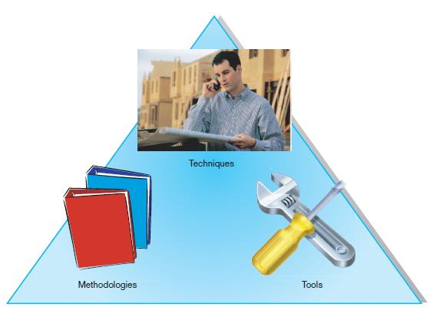
Introduction (Cont.)
FIGURE 1-1 An organizational approach to systems analysis and
design is driven by methodologies, techniques, and tools
Chapter 1

Slide 5
Introduction (Cont.)
Application Software
  Computer software designed to support organizational functions or processes
Systems Analyst
  Organizational role most responsible for analysis and design of information systems
Chapter 1

Slide 6
A Modern Approach to Systems Analysis and Design
1950s: focus on efficient automation of existing processes
1960s: advent of procedural third generation languages (3GL) faster and more reliable computers
1970s: system development becomes more like an engineering discipline
Chapter 1
Notes:
)

Slide 7
A Modern Approach to Systems Analysis and Design (Cont.)
1980s: major breakthrough with 4GL, CASE tools, object-oriented methods
1990s: focus on system integration, GUI applications, client/server platforms, Internet
The new century: Web application development, wireless PDAs and smart phones, component-based applications, application service providers (ASP)
Chapter 1
Notes:
phones

Slide 8
Developing Information Systems
System Development Methodology is a standard process followed in an organization to conduct all the steps necessary to analyze, design, implement, and maintain information systems.
Chapter 1

Slide 9
Systems Development Life Cycle (SDLC)
Traditional methodology used to develop, maintain, and replace information systems
Phases in SDLC:
  Planning
  Analysis
  Design
  Implementation
  Maintenance
Chapter 1

Slide 10
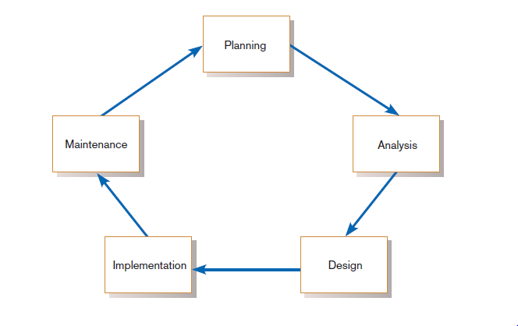
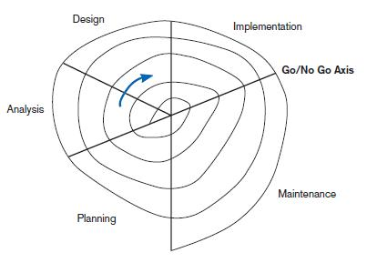
Standard and Evolutionary Views of SDLC
FIGURE 1-3 Evolutionary model
FIGURE 1-2
Systems development life cycle
Chapter 1

Slide 11
Systems Development Life Cycle (SDLC) (Cont.)
Planning – an organization’s total information system needs are identified, analyzed, prioritized, and arranged
Analysis – system requirements are studied and structured
Design – a description of the recommended solution is converted into logical and then physical system specifications
Chapter 1

Slide 12
Systems Development Life Cycle (SDLC) (Cont.)
Logical design – all functional features of the system chosen for development in analysis are described independently of any computer platform
Physical design – the logical specifications of the system from logical design are transformed into the technology-specific details from which all programming and system construction can be accomplished
Chapter 1

Slide 13
Systems Development Life Cycle (SDLC) (Cont.)
Implementation – the information system is coded, tested, installed and supported in the organization
Maintenance – an information system is systematically repaired and improved
Chapter 1

Slide 14
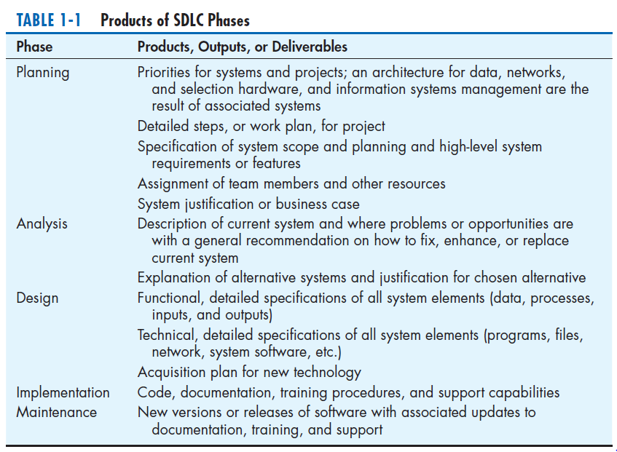
Chapter 1

Slide 15
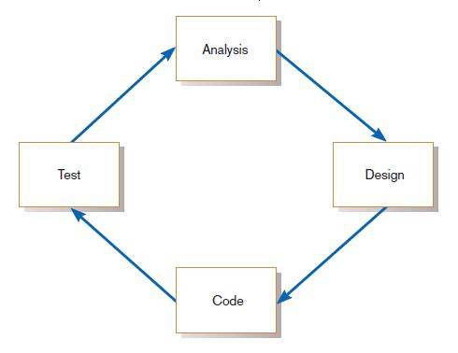
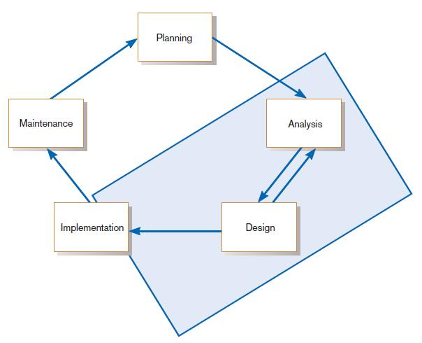
The Heart of the Systems Development Process
FIGURE 1-8
Analysis–design–code–test loop
FIGURE 1-9
The heart of systems development
Current practice combines analysis, design, and implementation into a single iterative and parallel process of activities.
Chapter 1

Slide 16
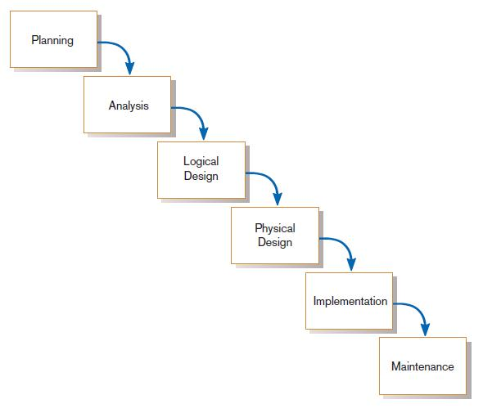
Traditional Waterfall SDLC
One phase begins when another completes, with little backtracking and looping.
FIGURE 1-10
Traditional waterfall SDLC
Chapter 1

Slide 17
Problems with Waterfall Approach
Feedback ignored, milestones lock in design specs even when conditions change
Limited user involvement (only in requirements phase)
Too much focus on milestone deadlines of SDLC phases to the detriment of sound development practices
Chapter 1

Slide 18
Different Approaches to Improving Development
CASE Tools
Rapid Application Development (RAD)
Agile Methodologies
eXtreme Programming
Chapter 1

Slide 19
Computer-Aided Software Engineering (CASE) Tools
Diagramming tools enable graphical representation.
Computer displays and report generators help prototype how systems “look and feel”.
IBM’s Rational products are the best known CASE tools.
Chapter 1

Slide 20
Computer-Aided Software Engineering (CASE) Tools (Cont.)
Analysis tools automatically check for consistency in diagrams, forms, and reports.
A central repository provides integrated storage of diagrams, reports, and project management specifications.
Chapter 1

Slide 21
Computer-Aided Software Engineering (CASE) Tools (Cont.)
Documentation generators standardize technical and user documentation.
Code generators enable automatic generation of programs and database code directly from design documents, diagrams, forms, and reports.
Chapter 1

Slide 22
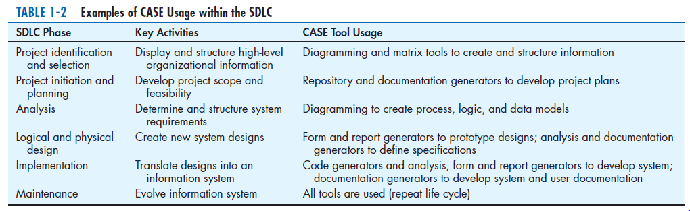
CASE Tools (Cont.)
Chapter 1

Slide 23
Rapid Application Development (RAD)
Decreases design and implementation time
Involves: extensive user involvement, prototyping, integrated CASE tools, code generators
More focus on user interface and system function, less on detailed business analysis and system performance
Chapter 1

Slide 24
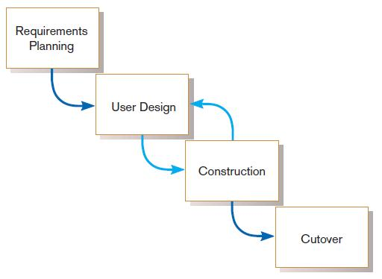
Rapid Application Development (RAD) (Cont.)
FIGURE 1-12
RAD life cycle
Chapter 1

Slide 25
Agile Methodologies
Motivated by recognition of software development as fluid, unpredictable, and dynamic
Three key principles
  Adaptive rather than predictive
  Emphasize people rather than roles
  Self-adaptive processes
Chapter 1

Slide 26
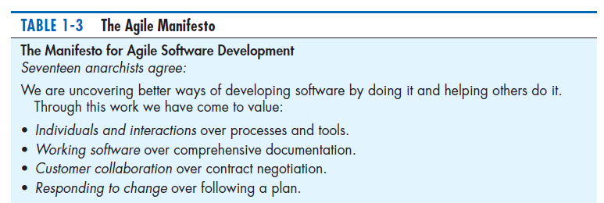
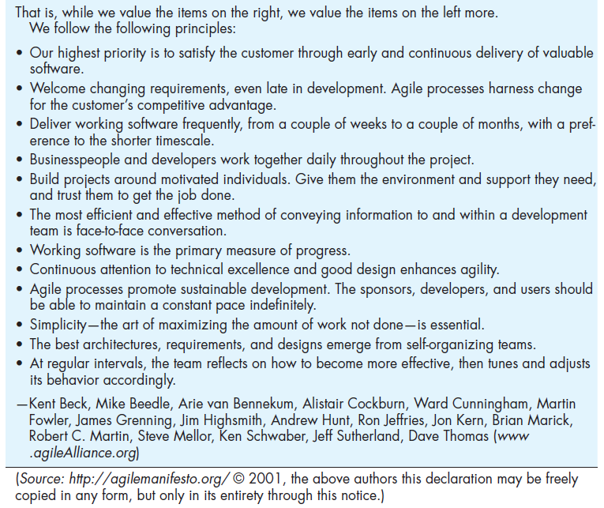
The Agile Methodologies group argues that software development methodologies
adapted from engineering generally do not fit with real-world software development.
Chapter 1

Slide 27
When to use Agile Methodologies
If your project involves:
  Unpredictable or dynamic requirements
  Responsible and motivated developers
  Customers who understand the process and will get involved
Chapter 1

Slide 28
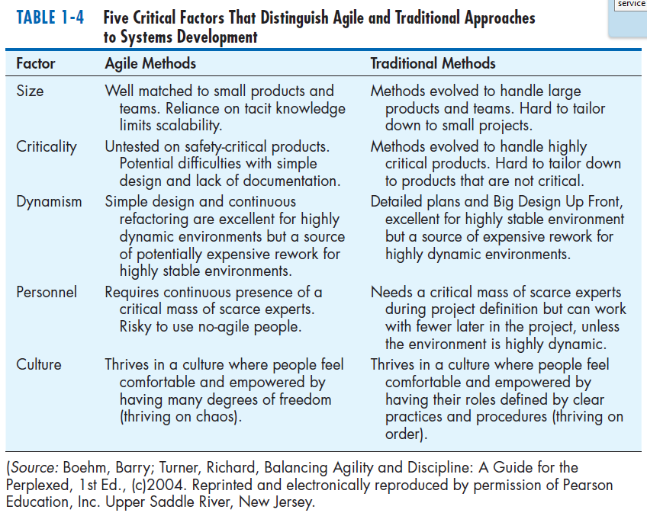
Chapter 1

Slide 29
eXtreme Programming
Short, incremental development cycles
Automated tests
Two-person programming teams
Coding, testing, listening, designing
Chapter 1

Slide 30
eXtreme Programming (Cont.)
Coding and testing operate together
Advantages:
  Communication between developers
  High level of productivity
  High-quality code
Chapter 1

Slide 31
Object-Oriented Analysis and Design (OOAD)
Based on objects rather than data or processes
Object: a structure encapsulating attributes and behaviors of a real-world entity
Chapter 1

Slide 32
Object-Oriented Analysis and Design (OOAD) (Cont.)
Object class: a logical grouping of objects sharing the same attributes and behaviors
Inheritance: hierarchical arrangement of classes enable subclasses to inherit properties of superclasses
Chapter 1

Slide 33
Rational Unified Process (RUP)
An object-oriented systems development methodology
Establishes four phase of development: inception, elaboration, construction, and transition
  Each phase is organized into a number of separate iterations.
Chapter 1

Slide 34
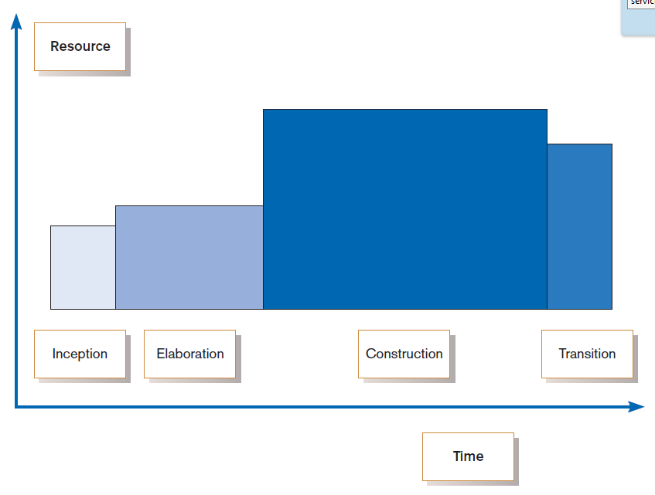
FIGURE 1-13
Phases of OOSAD-based development
Chapter 1

Slide 35
Our Approach to Systems Development
The SDLC is an organizing and guiding principle in this book.
We may construct artificial boundaries or artificially separate activities and processes for learning purposes.
Our intent is to help you understand all the pieces and how to assemble them.
Chapter 1

Slide 36
Summary
In this chapter you learned how to:
Define information systems analysis and design.
Describe the information Systems Development Life Cycle (SDLC).
Explain Rapid Application Development (RAD), prototyping, Computer Aided Software Engineering (CASE), and Service-Oriented Architecture (SOA).
Describe agile methodologies and eXtreme programming.
Explain Object-Oriented Analysis and Design (OOAD) and the Rational Unified Process (RUP).
Chapter 1

